Slide 1
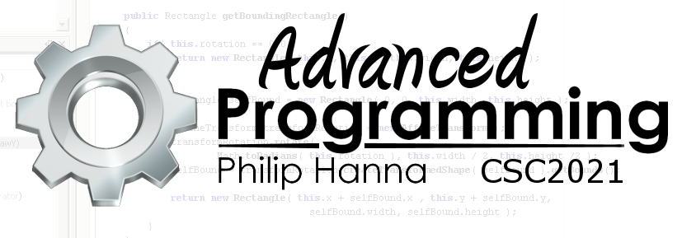
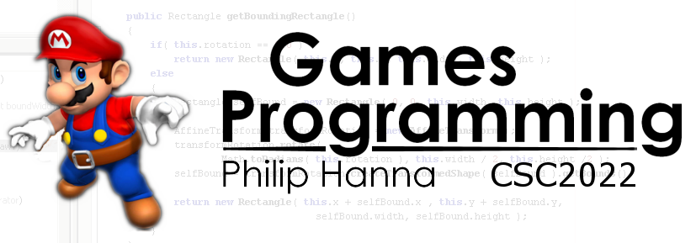
The Compilation Process
How code gets to be compiled
Part 1 - Different forms of translation

Slide 2


Source Code to Machine Code
Translation

Slide 3
Translation is the process of converting a source program into a machine language. Two broad approaches exist:
Interpreted
Compiled
An interpreter separately processes and then immediately executes each statement (line of code).
A compiler converts all statements into machine code, producing an executable program. A linker is used to link together the object code produced from compiled units.
Notes:
Translation is the process of converting a source program into a machine language. Two broad approaches exist:
Interpretation: Within an interpreted language an interpreter separately processes and then immediately executes each statement (line of code).
Early Java and other current languages such as Javascript/Perl can be viewed as interpreted
Compiled: Within a compiled language a compiler converts all statements into machine code producing an executable program which can then be run. A linker is used in this process to link together the code produced from compiled units.

Slide 4
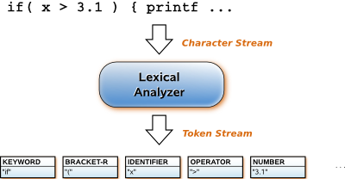
Let’s get more precise. Interpreters and linkers can be subdivided as follows:
Pure Interpreters
The text source file is scanned and processed as purely textual data. String parsing is used to identify lexemes (language components).
Pure interpreters are popular within limited /controlled systems (e.g. browser plugin)
But they are slow; more time can be spent in lexical analysis than in program execution. For high-level scripting languages this may not be a problem.
Notes:
Pure Interpreters
Within a pure interpreters the text source file is scanned and processed as purely textual data. String parsing is used to identify lexemes (language components).
Pure interpreters tend to be relatively small programs and hence popular within memory constrained systems (e.g. browser plugin).
But they are very inefficient. More time can be spent performing lexical analysis (string processing) than actually executing the program. For high-level scripting languages this may not be a problem.

Slide 5
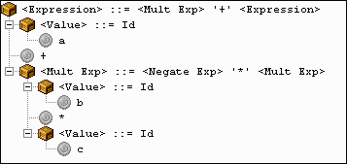
Interpreters
An interpreter executes some representation of the source file at runtime, although, this need not be in a human-readable form.
The output of source code lexical analysis can be stored in a compact tokenized format and then later parsed and executed by an interpreter token-by-token.
This increases the execution speed at the cost of an initial tokenization delay.
Notes:
Interpreters
An interpreter executes some representation of the source file at runtime, although, this need not be in a human-readable form.
A source file can undergo lexical analysis (identify language lexemes) which are then stored in a compact tokenized format and stored.
This can then be provided to an interpreter that coverts the tokens into machine code and executes each statement as encountered.
This considerably increases the execution speed at the cost of an initial delay whilst the source code is tokenized.

Slide 6
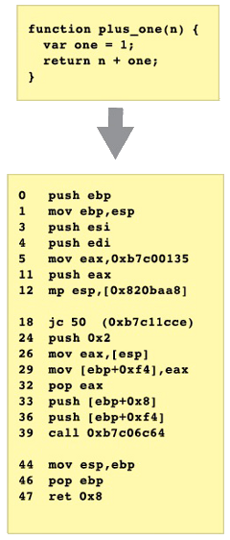
Compilers
A compiler translates source code into executable machine code. This is a complex process, particularly in optimizing compilers.
As translation is separated from execution the compiler can spend more time trying to optimise the created machine code. Also, as no translation cost is incurred at runtime, compiled programs typically run much faster than interpreted code.
Notes:
Compilers
A compiler translates a source program in text form into executable machine code. This is a complex process, particularly in optimizing compilers.
As an executable is produced no translation cost is incurred at runtime.
Additionally, as the process of translation is entirely separated from the process of execution there is less pressure to perform the translation quickly, i.e. the compiler can spend more effort (and time) to optimise the machine code that is produced. Compiled programs typically run much faster than interpreted code.

Slide 7
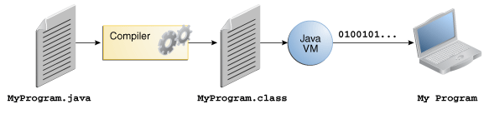
Incremental Compilers
An incremental compiler is a cross between a compiler and an interpreter. They convert source code into a virtual machine language which is then ‘run’ on a virtual machine. Java’s bytecode and .NET’s CIL are examples. This produces highly portable code that can run on multiple platforms.
To improve performance just-in-time (JIT) compilation is often used where virtual machine code is compiled into machine code as encountered. Whilst execution speed is good it still tends to be slower than code from a pure compiler
Notes:
Incremental Compilers
An incremental compiler is a cross between a compiler and an interpreter.
Incremental compilers typically convert source code into an intermediate form that can be viewed as machine code for a virtual (hypothetical) machine language (Java’s bytecode or .NET’s Common Intermediate Language).
This has the advantage of producing an output that is highly portable and can be run on any platform which has a supported interpreter for the virtual machine language. A compiler output is platform specific.
Whilst interpreted virtual machine code also runs faster than interpreted source code, it remains much slower than pure machine code.
As a means of improving performance, both Java and .NET languages make use of just-in-time compilation.
Just-in-time compilation translates the virtual machine code to actual machine code as it is encountered. This entails that loops, etc. run much faster once the first loop has been translated, although, JIT compilation tends not to produce as high quality machine code as a pure compiler.

Slide 8

Key takeaways:
A good compiler will work hard to help you write efficient programs (when you tell it to do so).
To best exploit the optimising abilities of your compiler you should write code in a compiler friendly manner.
Mostly this comes down to avoiding unnecessarily complex code (e.g. lots of unneeded branching).

